Slide 1
CSI 342: LECTURE 2 THE SYSTEMS DEVELOPMENT LIFE CYCLE (SDLC)
Objectives- At the end of this lecture, students are expected
To understand the Principles and techniques of
the Systems Development Life Cycle (SDLC)
To identify and be able to follow appropriate SDLC based on the nature of the system

Slide 2
What is SDLC ?
SDLC is a process used by Systems /IT analysts in order to develop or redesign high quality software system which meets both the customer needs and the real world requirements of an Information system for an organisation.
Benefits of the SDLC Process
The intent of a SDLC process it to help produce a product that is cost-efficient, effective, and of high quality. Once an application is created, the SDLC maps the proper deployment and decommissioning of the software once it becomes a legacy.
The SDLC methodology usually contains the following stages: Analysis (requirements and design), construction, testing, release, and maintenance (response)
The term life cycle is due to the iterative nature of the process

Slide 3
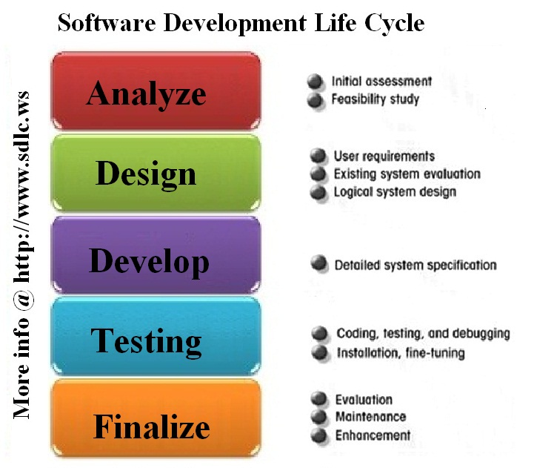
Images for SDLC ?

Slide 4
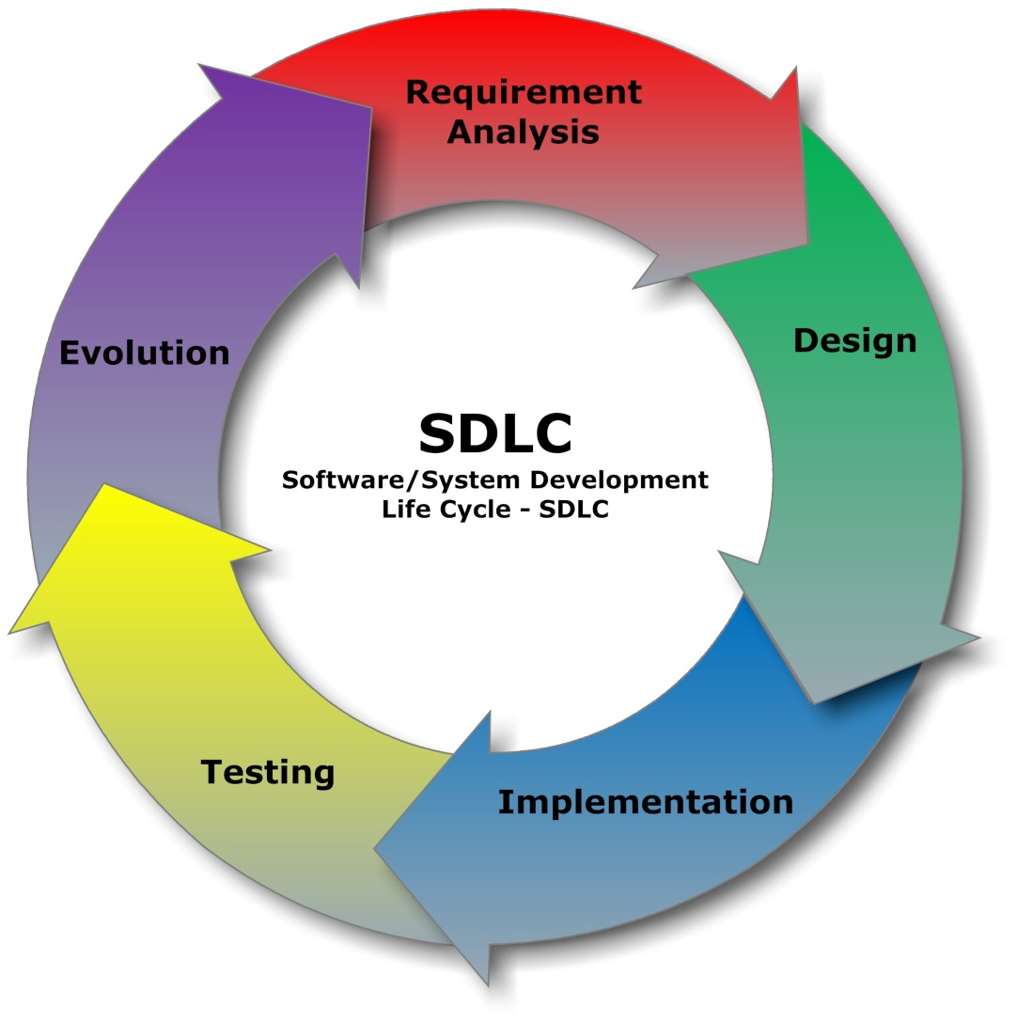
Images of SDLC

Slide 5
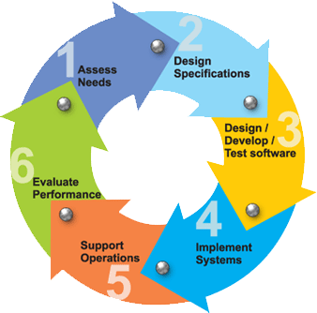
Images of SDLC

Slide 6
What is SDLC?
Referred to variously as the waterfall model and linear cycle, this methodology is a coherent description of the steps taken in the development of information systems. The reason why it is referred to as the waterfall model should be obvious from the following figure (from Horner, 1993):
Figure: Systems Development Life Cycle (See next slide)

Slide 7
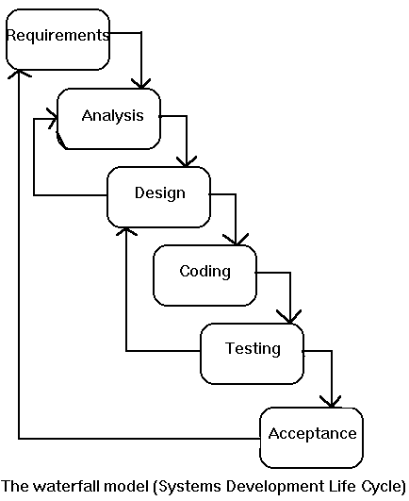
What is SDLC ?
:

Slide 8
What is SDLC ?
SDLC methodology closely linked to structured systems analysis & design. The series of steps to be undertaken in the development of information systems may be considered for simplicity as follows:
Problem definition: On receiving a request from the user for systems development, an investigation is conducted to state the problem to be solved.
Deliverables: Problem statement.
Feasibility study: The objective here is to clearly define the scope and objectives of the systems project, and to identify alternative solutions to the problem defined earlier.
Deliverables: Feasibility report.
Systems analysis phase: The present system is investigated and its specifications documented. They should contain our understanding of HOW the present system works and WHAT it does.
Deliverables: Specifications of the present system.
Systems design phase: The specifications of the present system are studied to determine what changes will be needed to incorporate the user needs not met by the system presently. The output of this phase will consist of the specifications, which must describe both WHAT the proposed system will do and HOW it will work.
Deliverables: Specifications of the proposed system.
Systems construction: Programming the system, and development of user documentation for the system as well as the programs.
Deliverables: Programs, their documentation, and user manuals.
System testing & evaluation: Testing, verification and validation of the system just built.
Deliverables: Test and evaluation results, and the system ready to be delivered to the user/client.

Slide 9
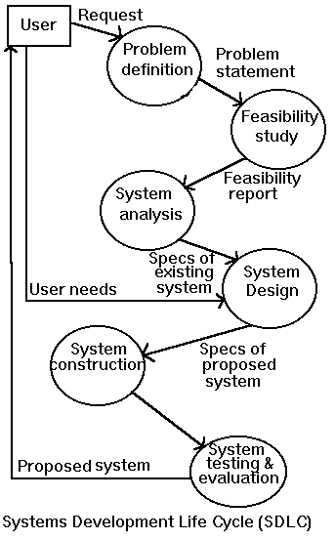

Slide 10
Advantages and Disadvantages
The waterfall model has many attractive features: Clearly defined deliverables at the end of each phase, so that the client can take decisions on continuing the project. Incremental resource commitment. The client does not have to make a full commitment on the project at the beginning. Isolation of the problem early in the process.
It does, however, have some drawbacks:
Requires an all-or-nothing approach to systems development. Does not allow incremental development. Requires very early isolation of the problem. In the real world, often the problems are uncovered in the process of development of systems.

Slide 11
The Systems Development Life Cycle (SDLC)
Originally, SDLC is the traditional approach used to develop, maintain and replace information systems
The fundamental phases include:
Phase 1 - Project Planning
Phase 2 – Project Analysis
Phase 3 – Project Design
Phase 4 – Project Implementation
Phase 5- Maintenance
Each phase is composed of a series of steps which rely upon techniques that produce deliverables (i.e specific documents and files that provide understanding about the project)
Today, SDLC is not limited to the fundamental phases, but includes the systematic approach analysts take to the analysis and design of information systems. You could have more phases or even less depending on the software development method chosen

Slide 12
SDLC in 7 phases
A 7 phases SDLC for an information system might include:
Phase 1- Identifying Problems, opportunities and objectives
Phase 2- Determining Human information requirements
Phase 3 – Analyzing System needs
Phase 4 – Designing the recommended system
Phase 5- Developing and documenting the software
Phase 6- Testing and Maintaining the system
Phase 7- Implementing and evaluating the system

Slide 13
From the 7 Phases
Phase 1- The analyst is concerned with correctly identifying problems, opportunities and objectives. The analyst must look honestly at what is occurring in the business to discover what the business is trying to do, pinpoint problems and look for opportunities for improvement through the use of computerized information systems. People involved at this stage are users, analysts, and system managers coordinating the project. Activities in this Phase include interviewing user management, estimating scope of project, and documenting result. The Output of this is a feasibility report containing a problem definition and summarizing the objectives. This report is presented to management to decides if the system project should go on or not.

Slide 14
Phase2- Determining Human Information Requirements
The Analyst’s work at this phase requires:
Determining the human needs of users involved in this system using tools such as questionnaires, observations, and prototyping .
The analyst should examine how to make the system useful to those involved by considering many factors such as how the system can better support individual tasks that needs doing, the information needs of users and how the system can be designed for ease of use etc
People involved a this stage are the analyst and users
The analyst needs to know the details of current system functions: the people involved (who), the business activity (what), environment (where), timing (when), current procedures (how) and why?
Reasons for doing business using current methods should also be considered in the new system.

Slide 15
Phase 3: Analyzing system needs
Special tools and techniques help the analyst make requirements determination:
Data Flow Diagram (DFD) are used to chart input , processes and output of business function
Activity diagram or sequence diagram are used to show the sequence of events occurring in the business
The analyst prepares a system proposal that summarizes what has been found about the users, usability, usefulness of current system, cost benefit analysis, makes recommendations to management as appropriate.

Slide 16
Phase 4-7
Phase 4-Design :Analyst uses information collected earlier to do a logical design system, and physical design. More of this shall be covered in detail later.
Phase 5- Develop and document the software
Phase 6- Test and maintain the system. Before the information system is used, it must be well tested with sample data to ensure it works according to specifications already agreed upon by both users, and analysts. Maintenance of the system and its documentation begins at this phase and is carried out routinely through out the life of the information system.
Phase 7- Implement and evaluate the system. The system is completely introduced into the business, users are trained to handle the system. Appropriate system conversion method is used to move from the old to the new system. Evaluation helps in determining system performance overtime.

Slide 17
Alternative SDLC Steps
Project planning, feasibility study: Establishes a high-level view of the intended project and determines its goals.
Systems analysis, requirements definition: Refines project goals into defined functions and operation of the intended application. Analyzes end-user information needs.
Systems design: Describes desired features and operations in detail, including screen layouts, business rules, process diagrams, pseudocode and other documentation.
Implementation: The real code is written here.
Integration and testing: Brings all the pieces together into a special testing environment, then checks for errors, bugs and interoperability.
Acceptance, installation, deployment: The final stage of initial development, where the software is put into production and runs actual business.
Maintenance: What happens during the rest of the software's life: changes, correction, additions, moves to a different computing platform and more. This, the least glamorous and perhaps most important step of all, goes on seemingly forever.

Slide 18
WHAT IS A PROJECT?
Key characteristics of a project
A planned activity
Specific objectives
Work to be carried out in several phases
Limited resources
Deadline
May be large and complex

Slide 19
Major Processes in Software System Project
Feasibility study
Analyze the general requirements, costs, and the functionalities and services provided/to be provided by the system being developed
Aimed to determine whether a system should be developed or not
Can be viewed as a project itself

Slide 20
Major Processes in Software System Project
Project Planning and Management. This will be covered in detail later in this course. A good starting point in this is for the analyst to:
To know the nature of the system to be developed : a Mgt Info System (MIS) or a Control system; Enterprise System (ERP)…
To know clearly the objectives and products of the project: How to evaluate the objectives and products after the completion of the project.
Appropriate activity planning and control of the project is established.

Slide 21
Major Processes in Software System Project
Project Execution. Execution follows from the adopted project management approach. Execution might involve basically but not limited to the following:
Systems Analysis
Systems Design
System Implementation
System Maintenance

Slide 22
Common problems with Software System Projects
Lack of quality standards and measures
Difficult to make the progress visible
Poor communication
Poor documentation
Frequent changes of requirements
Over budget and late delivery of software
These challenges call for appropriate techniques, standards and professional training for would be software developers and systems analysts
Aim to become a professional software specialist/analyst.

Slide 23
SYSTEMS ANALYSIS ANS DESIGN (SAD)
SAD is the complex organizational process whereby computer based information systems are developed and maintained with the intent of improving organizational processes
Systems Analysis answers the following questions:
Who will use the system ?
What will the system do?
Where and when will the system be used?
The project team(those involved in developing the system) must investigate any current system(s) in operation, identify opportunities for improvement and develop a concept for the new system

Slide 24
System Development Methods
The SDLC is the traditional approach in developing a new information system.
Alternative Approaches under certain circumstances might include Agile Methodology and Object-Oriented Methodology.
Agile approach is based on values, principle and core practice. The four values are communication, simplicity, feedback and courage. Systems analysts should adopt these values in all projects they undertake, not just when adopting the Agile approach. In other to finish a project adjustments often need to be made in project management. Important resources such as time, costs, quality and scope may be adjusted for successful completion of projects.

Slide 25
5 Stages of Agile Modeling Development Process
Exploration- explore your environment, assert your conviction that the problem requires Agile approach, assemble team, assess team member skills. Duration is from a few weeks to a few months. Also examine potential technologies needed to build the system, practice estimating time needed for a variety of tasks, ensure the customer is actively involved and experimenting with writing refined user stories which the analyst can use in estimating the time it will take to build the solution into the system being planned. Adopt a playful and curious attitude towards the work environment, its problems, technologies and people
Planning- Planning here takes just a few days for the analyst and customer to set time frames for the project delivery: 2months to half a year. If the analyst has done sufficient exploration, planning time will be short. Two main players in planning: the development team and the business customer. The customer decides what the team tackles first.

Slide 26
5 stages of Agile Approach
Iteration to the First release- these are cycles of testing, feedback and change. Lasts for about 3 weeks. Push to sketch out the entire architecture of the system even though it is still in outline. Run customer written functional test at the end of each iteration, question whether the schedule needs to be altered or that you are tackling too many stories, involve customer, developers as much as possible and celebrate progress no matter how small as part of motivation for hard work.
Productionizing- Speed up feedback cycle by having weekly software revision turn around, institute daily briefing so every one knows progress, release product in phases, improve by adding features, celebrate progress and make fun of system develop .
Maintenance to keep system running smoothly after delivery. New features may be added, riskier customer suggestions may be considered, team members may be rotated on or off, keep very amiable and considerable environment.

Slide 27
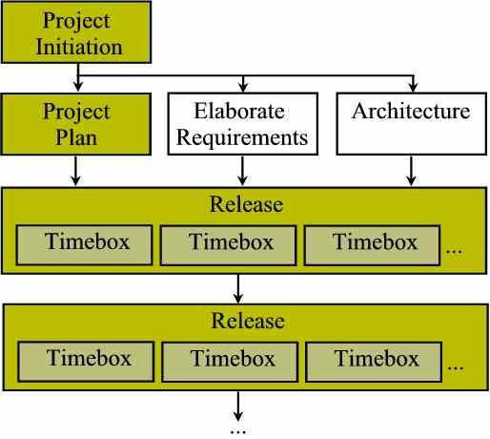
The Agile SDLC

Slide 28
Object Oriented System Analysis and Design (OOSAD)
Approach is used for systems that must change rapidly in response to dynamic business environments.
It is different from the structured approach of the traditional SDLC
The analyst should analyze the project to decide if it is more appropriate to use OOSAD or otherwise.
OOSAD uses Universal Modeling Language (UML) an industry standard to break down systems into a use case model.
Phases in UML are similar to those in SDLC in that they follow a rigid and exacting approach unlike the Agile approach which allows flexibility

Slide 29
Steps in UML approach
Define the use case model
Draw UML diagrams (Analysis Phase)
Develop class diagram (Analysis Phase)
Develop state chart diagram (Analysis Phase)
Design by modifying UML diagrams (Design Phase)
Develop and document the system (Development Phase)
OO methods often focus on small, quick iterations of development (spiral model): Analysis is first performed on small part of the system of high priority, then those of high risks (low priority). This is followed by design and implementation. The cycle is repeated with analysis of the next part in order of priority, designed and implemented

Slide 30
UML Development Process (Life Cycle)
Begin
OO AD
Draw Use Case diagrams
Write Use Case Scenarios
Derive Activity Diagram from use cases
Develop Sequence Diagrams
Create Class diagrams
Draw State chart diagrams
Modify diagram & complete spec
Develop & Doc
System
System Design
Phase
Problem Identification Phase
Analysis Phase

Slide 31
Choosing System Development Method to Use
Traditional SDLC is used when:
Systems have been developed and documented using SDLC
It is important to document each step of the way
Upper level management feels more comfortable or safe using SDLC
There are adequate resources and time to complete the full SDLC
Communication of how new systems work is important

Slide 32
Choosing Systems Development Method to Use
Agile method is Used When:
There is a project champion of agile method in the organization
Application needs to be developed quickly in response to a dynamic environment
A rescue takes place (system failed and there is no time to figure out what went wrong
The customer is satisfied with incremental improvements
Executives and analysts agree with the principle of agile methodologies

Slide 33
Choosing Systems Development Method to Use
Object-Oriented method is Used when:
the problem modeled lend themselves to classes
An organization support the UML learning
Systems can be added gradually, one sub system at a time
Reuse of previously written software is a possibility
It is acceptable to tackle to tackle the difficult problem first

Slide 34
ANALYSIS MODELING
Answers the following questions:
Who will use the system?
What will the system do?
Where and when will it be used?
Detailed requirements are identified and a system proposal is created
The team produces a functional model , structural model and behavioral model
More about these models shall be discussed

